Slide 1
《Discovering State Variables Hidden in Experimental Data》
中国科学技术大学 数据科学（数学） 许笑颜

Slide 2
Chapter 1 Framework
Introduction
Research Framework

Slide 3
Introduction
Most data-driven methods for modeling physical phenomena still assume that observed data streams already correspond to relevant state variables. A key challenge is to identify the possible sets of state variables from scratch, given only high-dimensional observational data.
Here we propose a new principle for determining how many state variables an observed system is likely to have, and what these variables might be, directly from video streams.
大多数用于建模物理现象的数据驱动方法仍然假设观察到的数据流已经对应于相关的状态变量。→从头开始识别可能的状态变量集，只给定高维观测数据的状态变量集。
研究目的：零物理的先验知识下，明确地识别系统的内在维度（Intrinsic Dimension）和相应的隐藏状态变量（State Variables）。
研究工作：基于一个自动编码神经网络，将高维视觉观测映射到相对低维嵌入，然后将其投影到高维图像空间，以预测未来的视频帧。
Idea：从视频流中识别物理系统中的观测状态变量（State Variable）
Question：如何确定候选变量个数？候选变量构成的集合是否唯一？

Slide 4
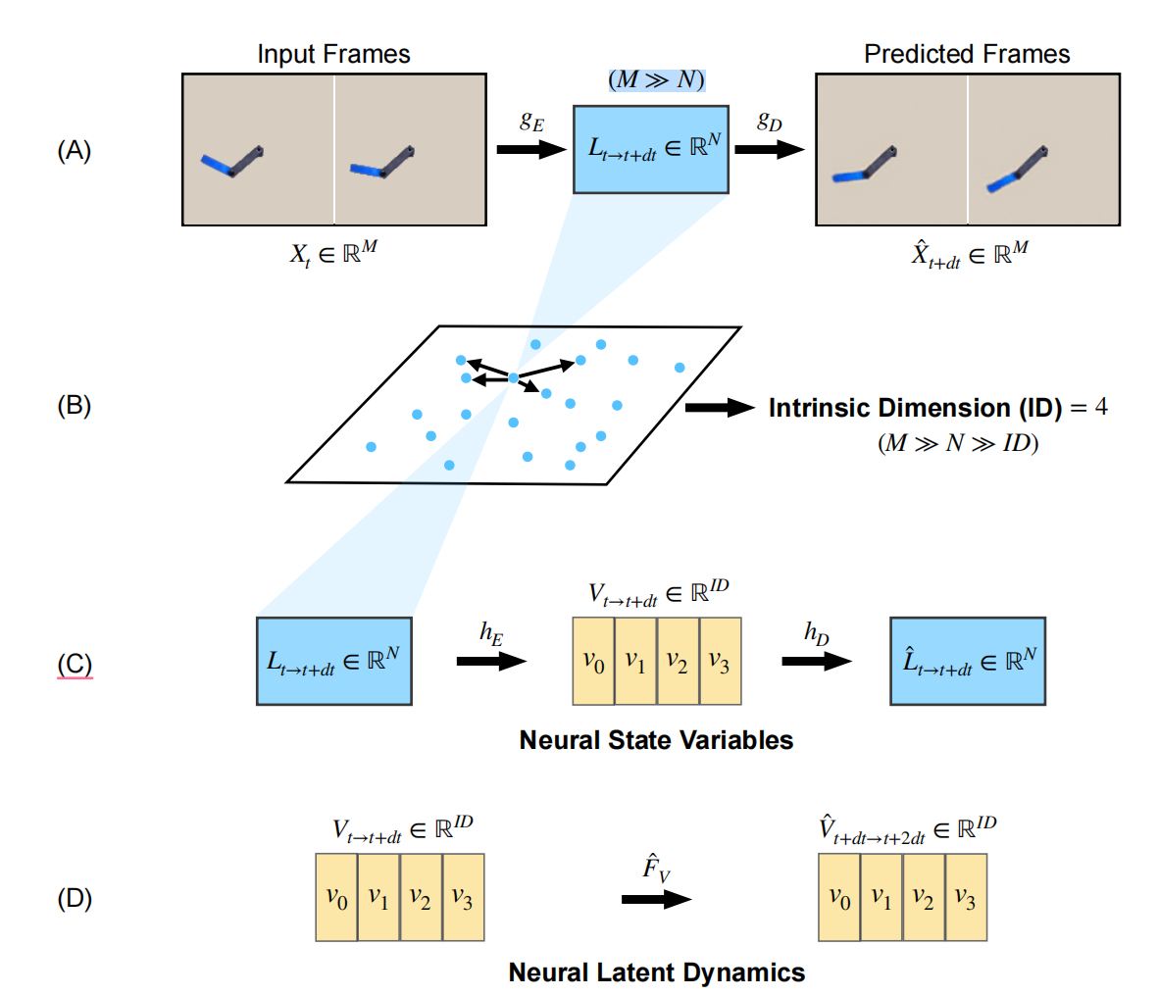
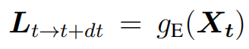
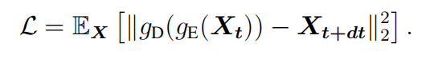
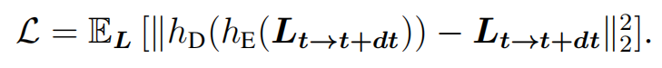
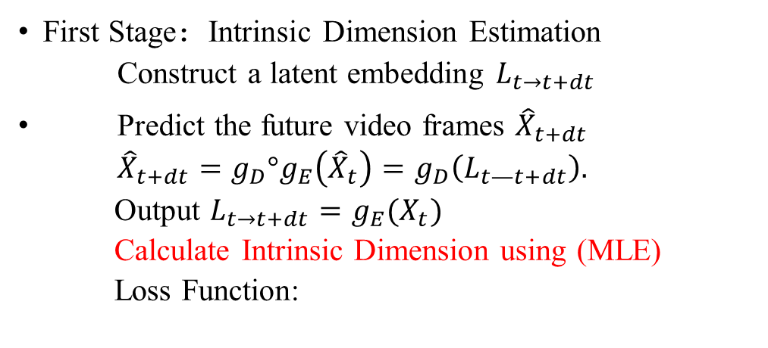
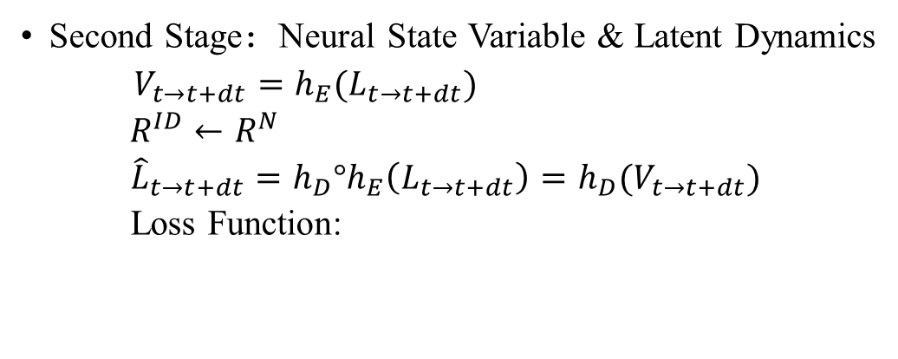
Research Framework
dynamics predictive model
First Stage：Intrinsic Dimension Estimation
Construct a latent embedding $L_{t→t+dt}$
Predict the future video frames ${\hat{X}}_{t+dt}$
${\hat{X}}_{t+dt}=g_{D}°g_{E}\left({\hat{X}}_{t}\right)=g_{D}\left(L_{t—t+dt}\right).$
Output $L_{t→t+dt}=g_{E}(X_{t})$
Calculate Intrinsic Dimension using (MLE)
Loss Function:
latent reconstruction model
Second Stage：Neural State Variable & Latent Dynamics
$V_{t→t+dt}=h_{E}(L_{t→t+dt})$
$R^{ID}←R^{N}$
${\hat{L}}_{t→t+dt}=h_{D}°h_{E}\left(L_{t→t+dt}\right)=h_{D}(V_{t→t+dt})$
Loss Function:
Notes:
First, after training the dynamics predictive neural network, we calculate the minimum number of independent variables needed to describe the dynamical systems, known as its *intrinsic dimension*, with geometric manifold learning algorithms.
在训练动态预测神经网络后，我们用几何流形学习算法计算描述动态系统所需的最小自变量数，称为其内在维数。
第一阶段主要任务：train a dynamics predictive model and identify the intrinsic dimension ID as indicated in the previous section.
训练了一个动态预测网络，并且识别了ID维度。
Armed with the intrinsic dimension obtained in the first stage, in the second stage, we design a latent reconstruction neural network to further identify the governing state variables with the exact dimension as the intrinsic dimension. We term these identified state variables *Neural State* *Variables*. Through both quantitative and qualitative experiments, we demonstrated that Neural State Variables can accurately capture the overall system dynamics.
在第二阶段，我们设计了一个潜在的重构神经网络，以进一步识别以精确维数为内在维数的控制状态变量。我们将这些已确定的状态变量称为神经状态变量。

Slide 5
Chapter 2 Evaluation
Evaluation 1 -Neural State Variables for Stable Long-Term Prediction
Evaluation 2 -Neural State Variables for Dynamics Stability Indicators
Evaluation 3 -Neural state variables for robust long-term prediction

Slide 6
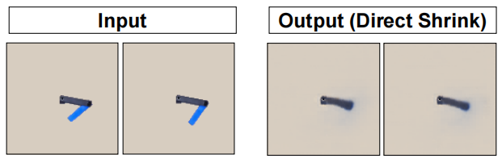
Evaluation 1 -Neural State Variables for Stable Long-Term Prediction
One-Step Prediction Accuracy: The learned dynamics may not be accurate since prediction errors are iteratively introduced at every prediction step.
Long-term Prediction Stability: Due to error accumulation, the predicted sequences may not be able to maintain the ground truth state space: one repeated observation from past studies is that the long-term predicted sequences become blur, heavily distorted, or plain background within only a few rollouts. We also observed similar phenomena in our experiments as shown in Fig. 4(A). This is a very important issue to resolve because if objects deform or entirely disappear without following the system dynamics, it would be impossible to follow the system evolution faithfully. Here, we first define this phenomena as long-term prediction stability. We then present quantitative analysis for various prediction schemes. Finally, we will present our solution to approach the stability challenge with Neural State Variables. 因为如果物体变形或不完全消失，就不可能忠实地跟踪系统的演化。
Notes:
一步预测精度是指，模型在每一次预测时的准确度。由于预测误差会在每一步预测中被迭代地引入，学习得到的动力学模型可能不够准确。
长期序列预测稳定性是指，模型在进行多步预测时保持预测序列稳定性的能力。由于误差积累，经过多次演算（或称为推演，rollouts）之后，模型生成的预测序列可能会与实际（即系统动力学所决定的真实状态空间）不相匹配。长期预测的序列可能变得模糊，严重失真，或者仅呈现简单的背景图像。这是因为随着时间推移，由于累积误差的影响，物体可能会变形或完全消失，从而无法准确地跟踪系统的动态演化。

Slide 7
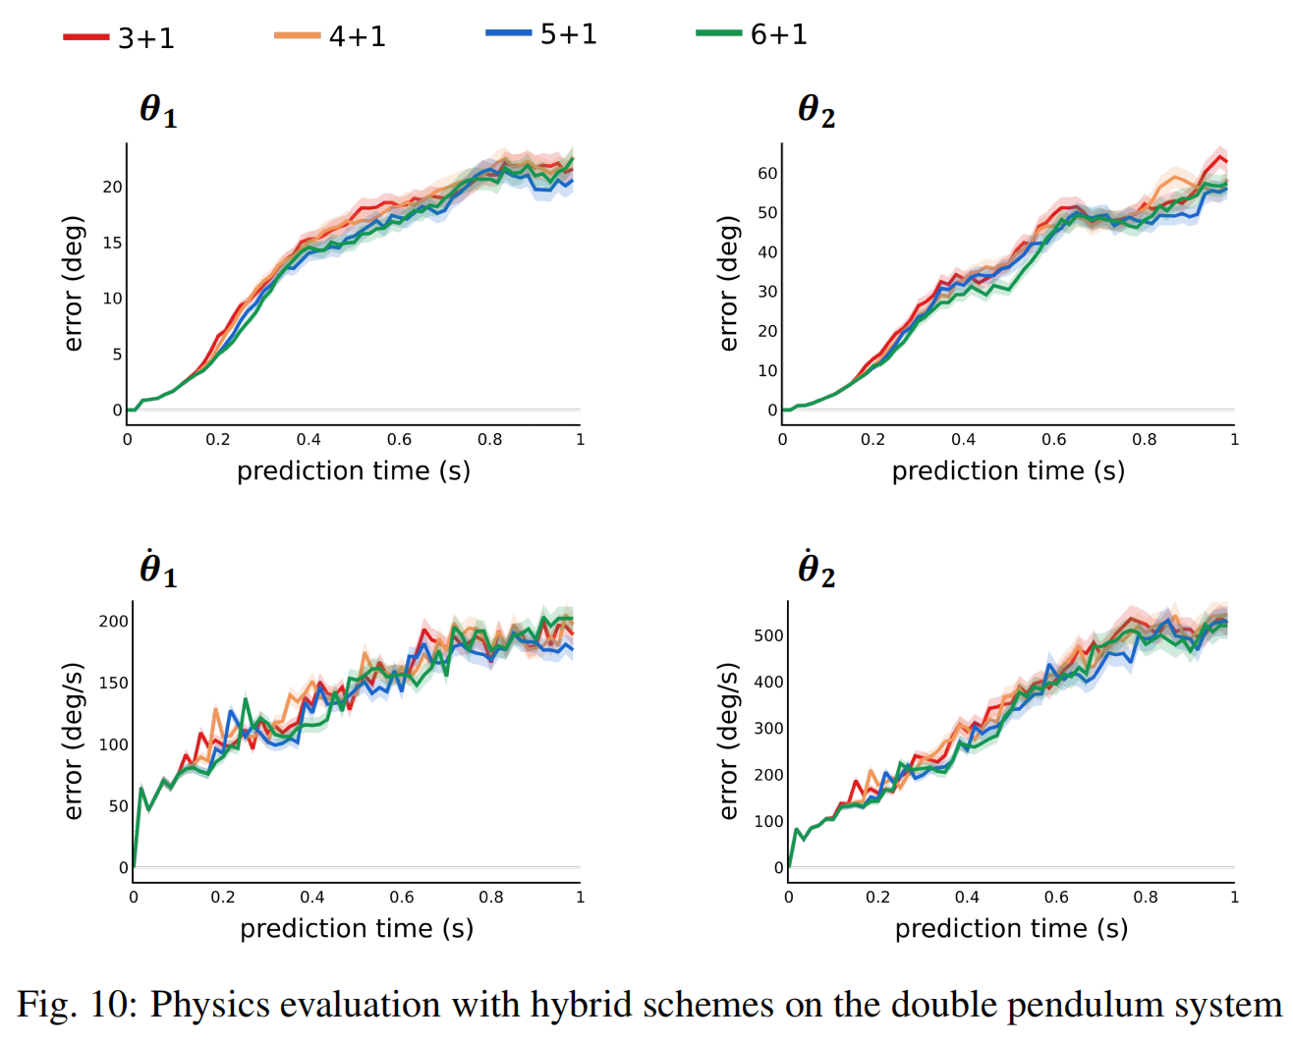
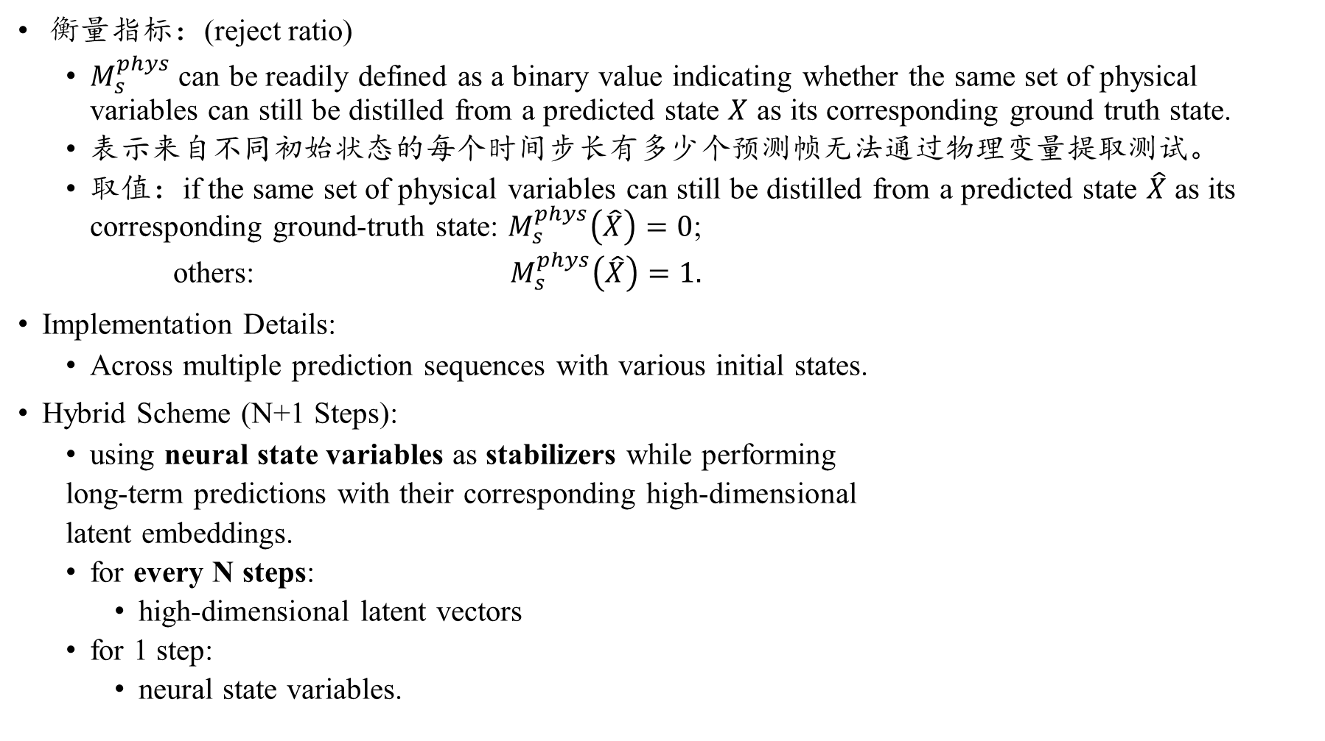
Evaluation 1 -Neural State Variables for Stable Long-Term Prediction
衡量指标：(reject ratio)
$M_{s}^{phys}$ can be readily defined as a binary value indicating whether the same set of physical variables can still be distilled from a predicted state $X$ as its corresponding ground truth state.
表示来自不同初始状态的每个时间步长有多少个预测帧无法通过物理变量提取测试。
取值：if the same set of physical variables can still be distilled from a predicted state $\hat{X}$ as its corresponding ground-truth state: $M_{s}^{phys}\left(\hat{X}\right)=0$;
others: $M_{s}^{phys}\left(\hat{X}\right)=1.$
Implementation Details:
Across multiple prediction sequences with various initial states.
Hybrid Scheme (N+1 Steps):
using neural state variables as stabilizers while performing
long-term predictions with their corresponding high-dimensional
latent embeddings.
for every N steps:
high-dimensional latent vectors
for 1 step:
neural state variables.
Not sensitive to N!
Notes:
对于观测$X$提取出来先验已知的物理变量，
然后看利用Latent Reconstruction Network提取出来的$\hat{X}$ 的物理神经状态变量是否包含。
\如果预测帧过于模糊或扭曲，将无法提取有意义的物理变量，这时M_S指标将为1（表示错误或拒绝）。否则，M_S指标将为0（表示正确接受）。

Slide 8
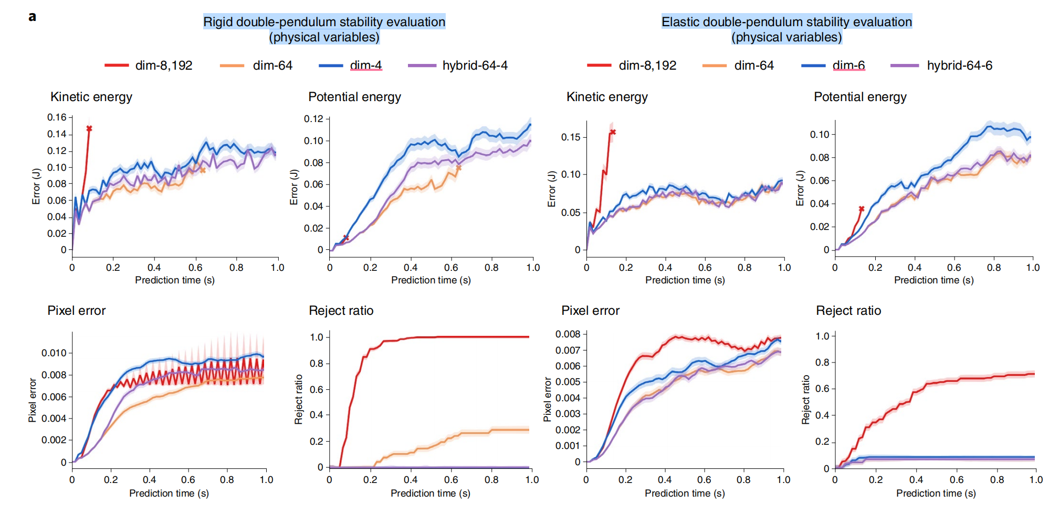
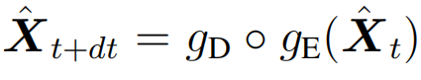
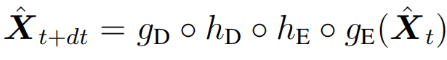
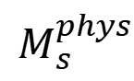
Evaluation 1 -Neural State Variables for Stable Long-Term Prediction
8192与64：代表的是latent embedding的维度；
（baseline）
4和6：不仅代表原始的维度，也代表本文利用了ID算法计算出来的刚性双摆稳定度、弹性双摆稳定性的内在维度。
$$M_{s}^{phys}$$

Slide 9
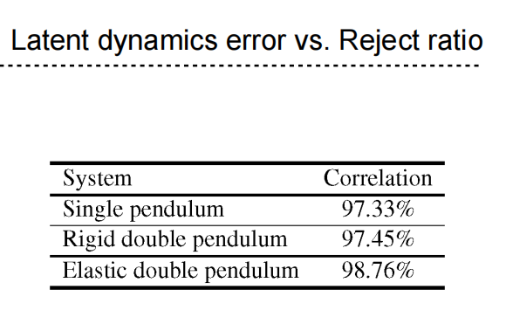
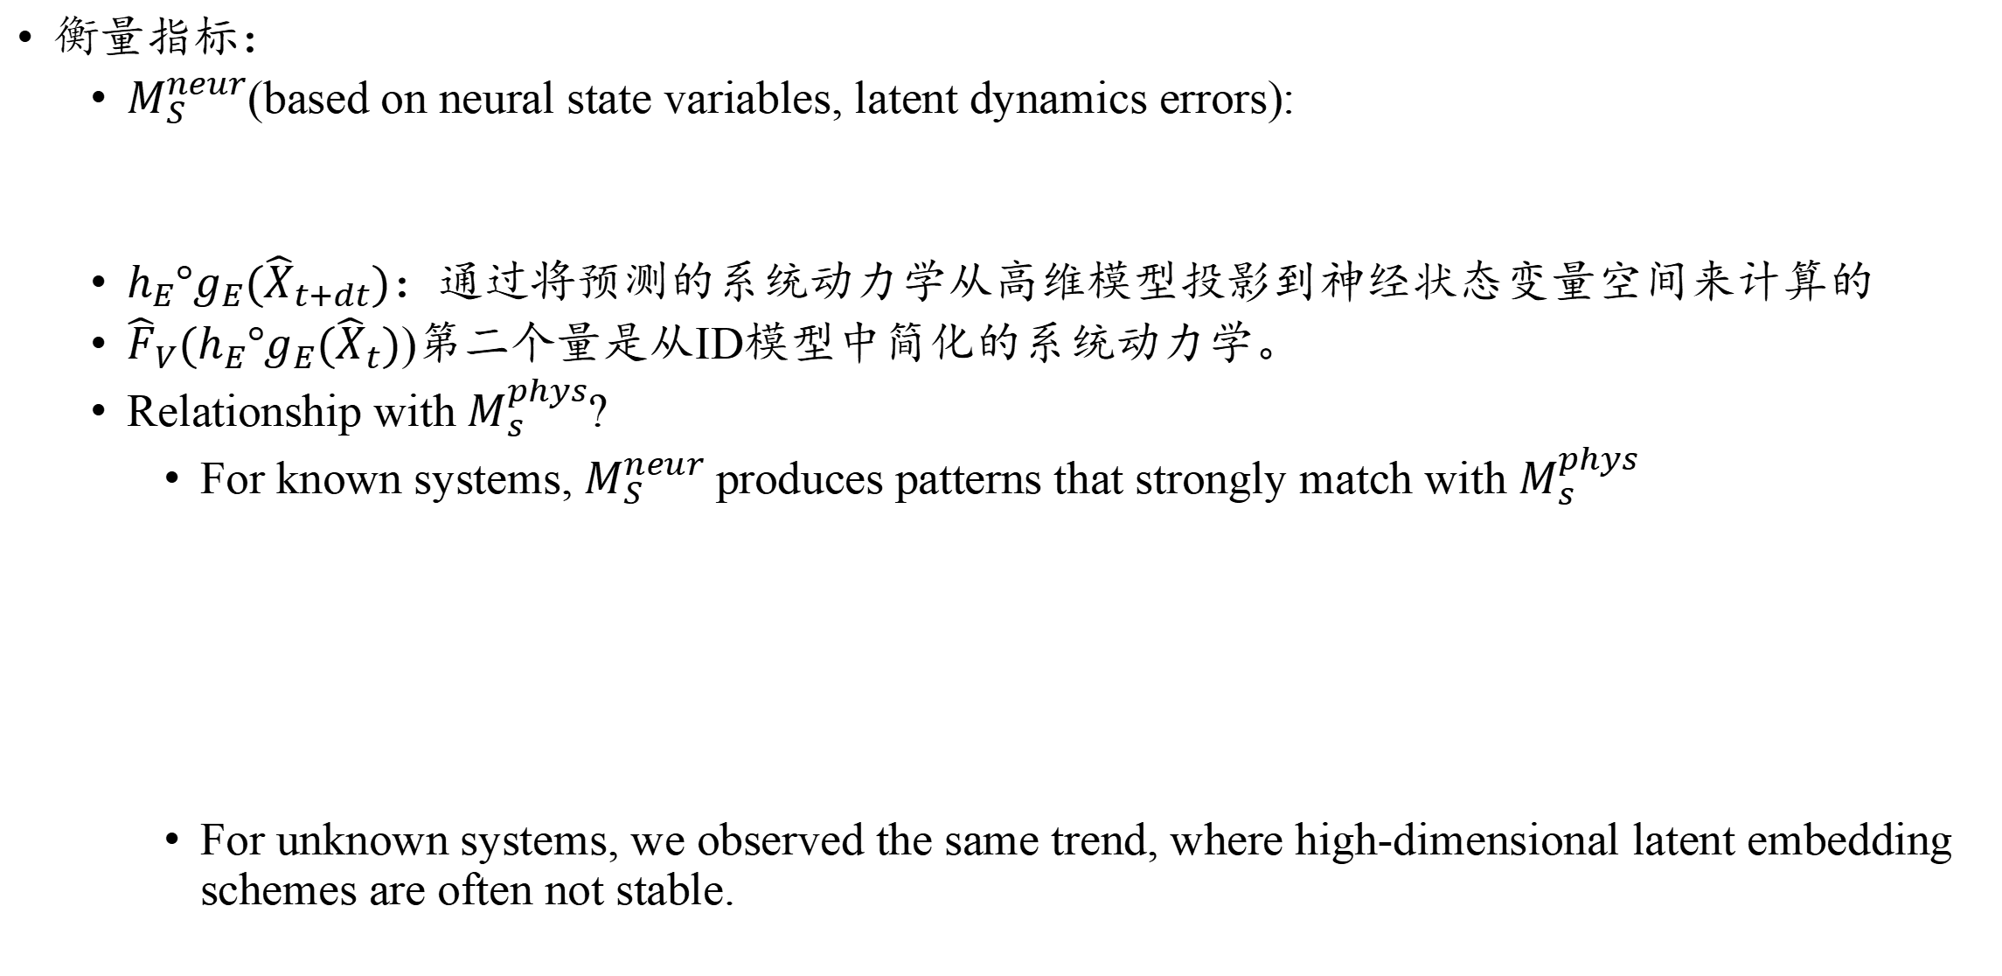
Evaluation 2 -Neural State Variables for Dynamics Stability Indicators
衡量指标：
$M_{S}^{neur}$(based on neural state variables, latent dynamics errors):
$h_{E}°g_{E}({\hat{X}}_{t+dt})$：通过将预测的系统动力学从高维模型投影到神经状态变量空间来计算的
${\hat{F}}_{V}(h_{E}°g_{E}({\hat{X}}_{t})$)第二个量是从ID模型中简化的系统动力学。
Relationship with $M_{s}^{phys}$?
For known systems, $M_{S}^{neur}$produces patterns that strongly match with $M_{s}^{phys}$
For unknown systems, we observed the same trend, where high-dimensional latent embedding schemes are often not stable.

Slide 10
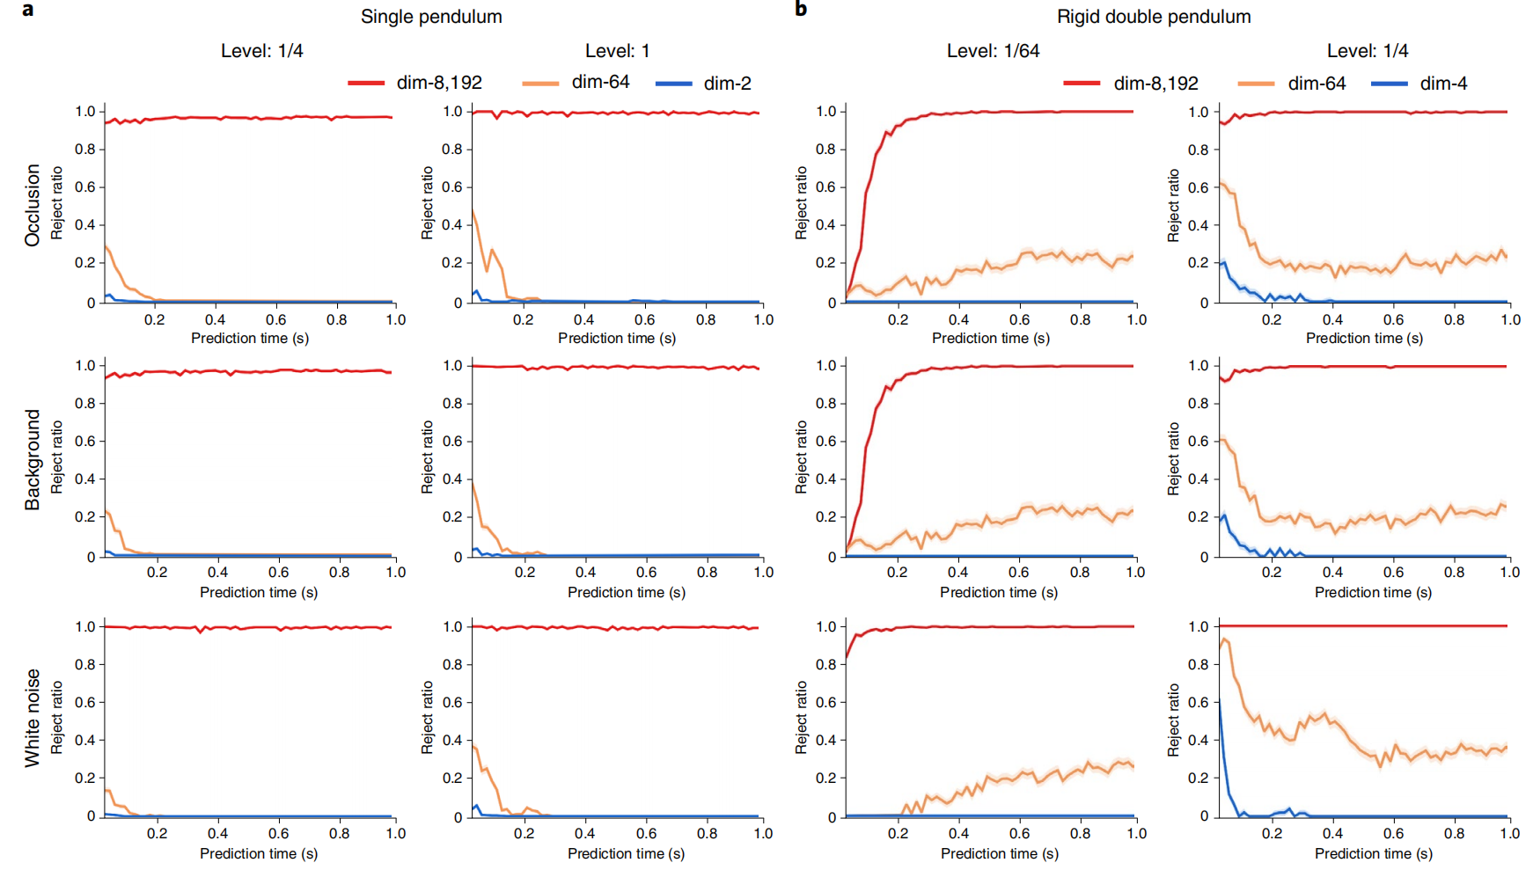
Evaluation 3 - Neural state variables for robust long-term prediction.
Method：引入Occlusion（遮挡噪声）、Background（背景噪声）、White noise（白噪声）

Slide 11
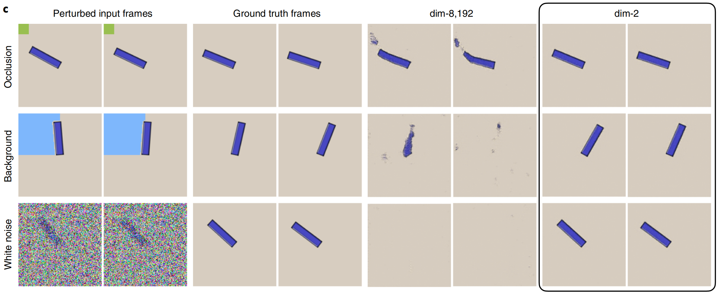
Evaluation 3 - Neural state variables for robust long-term prediction
Method：引入Occlusion（遮挡噪声）、Background（背景噪声）、White noise（白噪声）

Slide 12
Chapter 3 Algorithm Detail
Detail 1 - Calculate Intrinsic Dimension
Detail 2 - Math Proof on Long-Term Prediction Stability

Slide 13
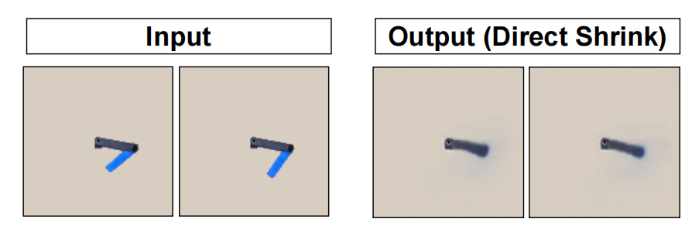
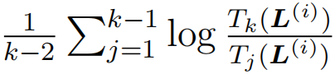
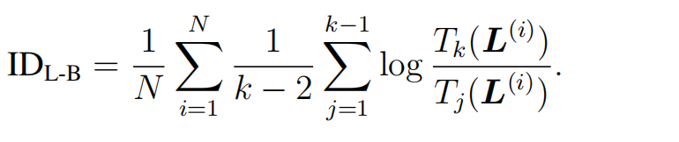
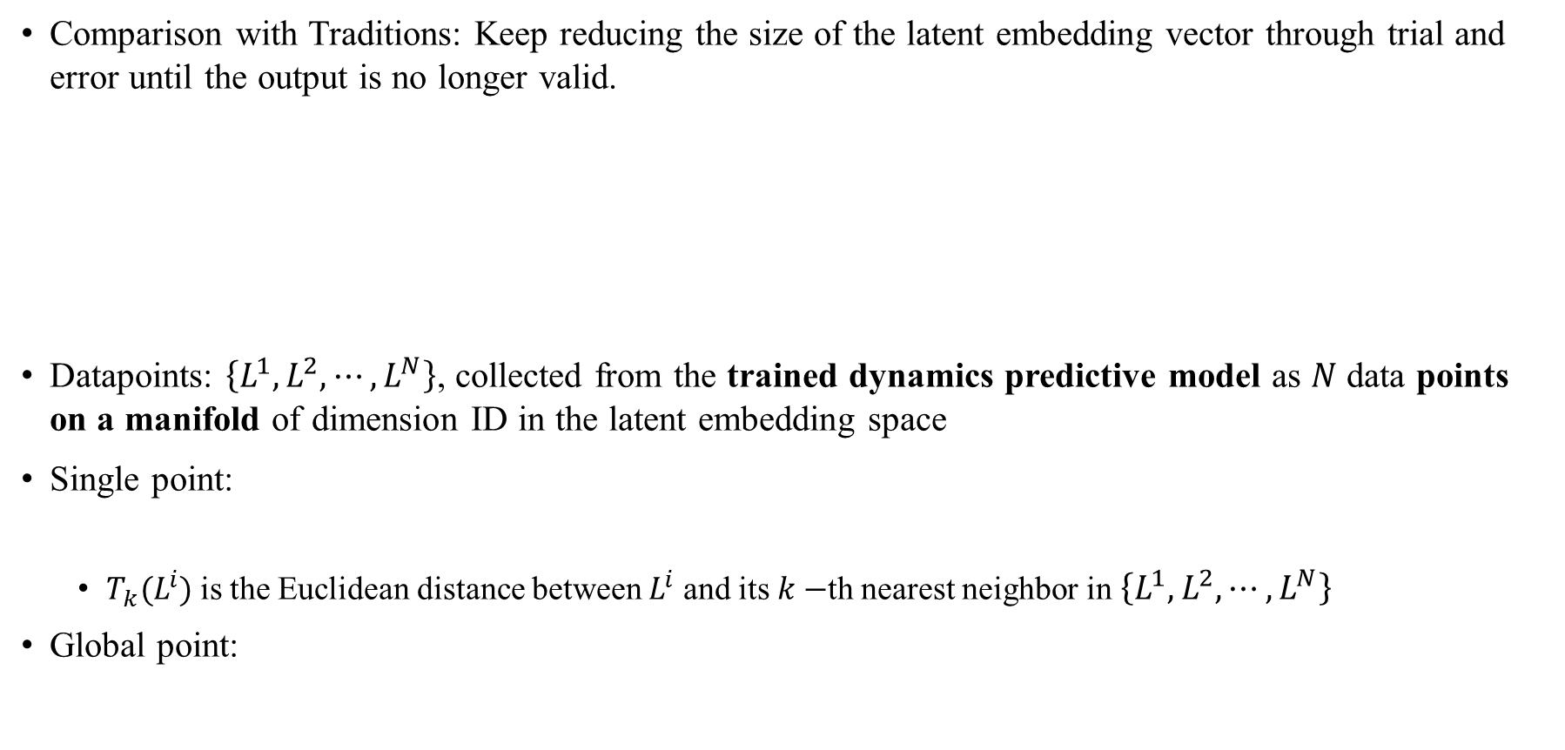
Detail 1 - Calculate Intrinsic Dimension
Comparison with Traditions: Keep reducing the size of the latent embedding vector through trial and error until the output is no longer valid.
Datapoints: $\left\{L^{1},L^{2},⋯,L^{N}\right\}$, collected from the trained dynamics predictive model as $N$ data points on a manifold of dimension ID in the latent embedding space
Single point:
$T_{k}(L^{i})$ is the Euclidean distance between $L^{i}$ and its $k−$th nearest neighbor in $\left\{L^{1},L^{2},⋯,L^{N}\right\}$
Global point:
Notes:
假设L向量是从潜在嵌入空间中，一个维度为ID的流形的一个训练动态预测模型上采集到的N个数据点。以一种更定量的方式，内在维数可以等价地定义为状态空间S的拓扑维数，作为环境空间X中的一个流形（30-32）。
使用自动编码器预测框架的一种简单方法是通过反复试验不断减少潜在嵌入向量的大小，直到输出不再有效。然而，这种方法并不能产生令人满意的结果，因为输出早在达到最小状态变量集之前就会恶化。如图4(A)所示，当我们直接将潜在空间的大小缩小到内在维度时，模型的预测就失效了

Slide 14
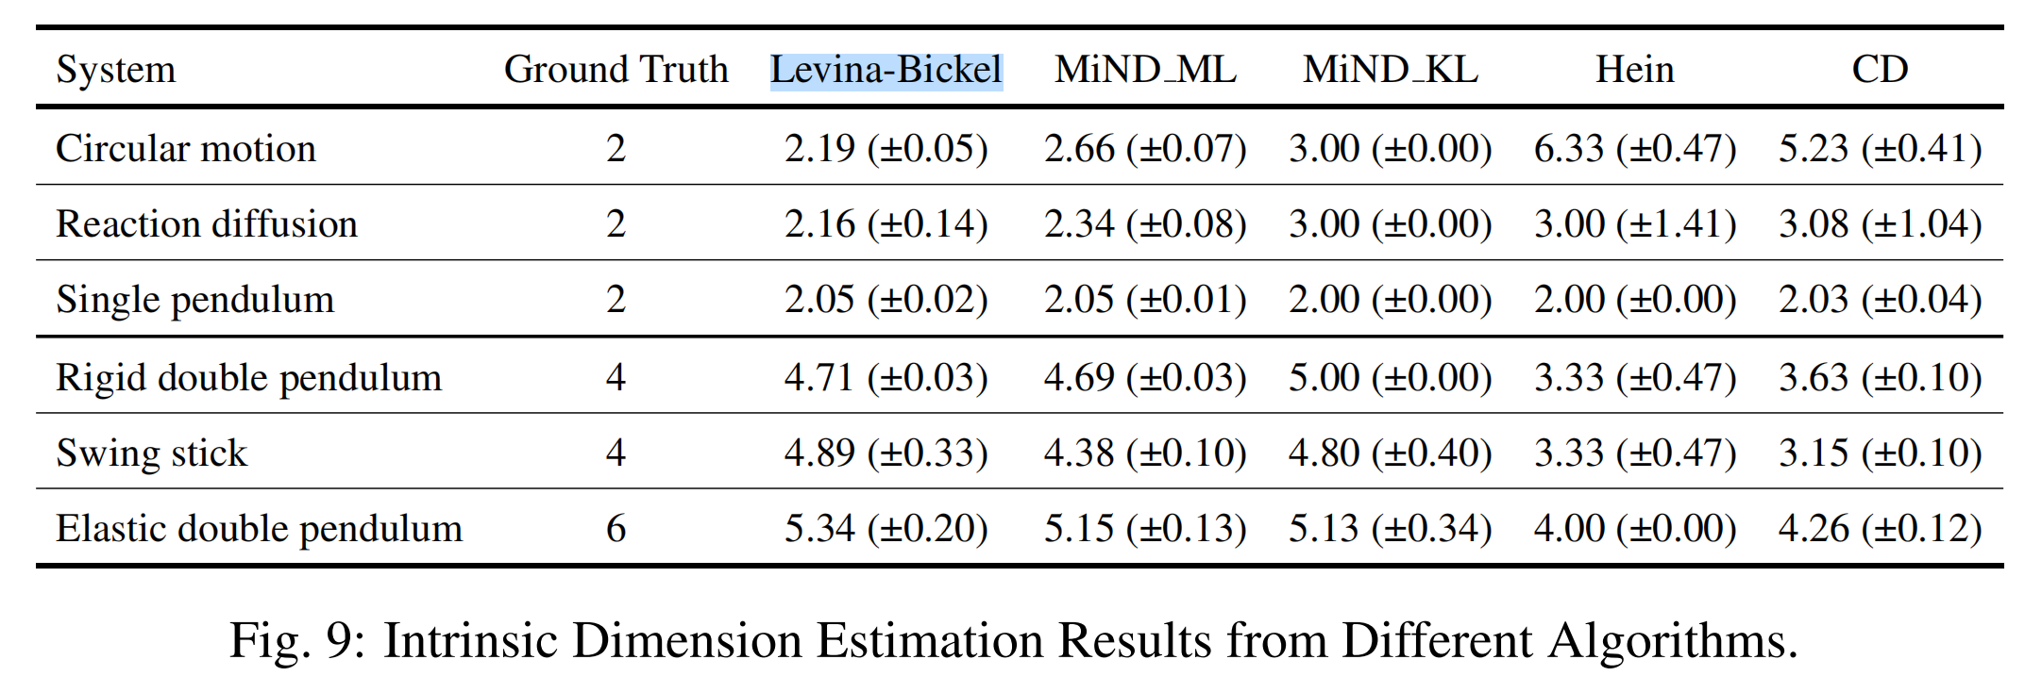
Detail 1 - Calculate Intrinsic Dimension
Comparison with other method:
Conclusion: the Levina-Bickel algorithm gives the most robust and reliable estimation.
Algorithm: Maximum likelihood estimation (MLE)

Slide 15
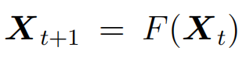
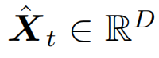
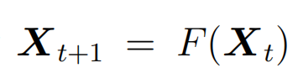
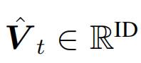
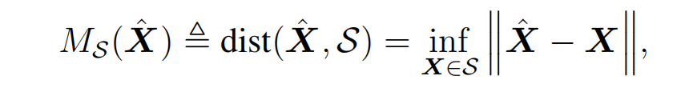
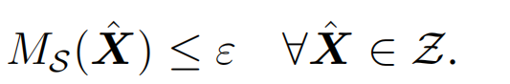
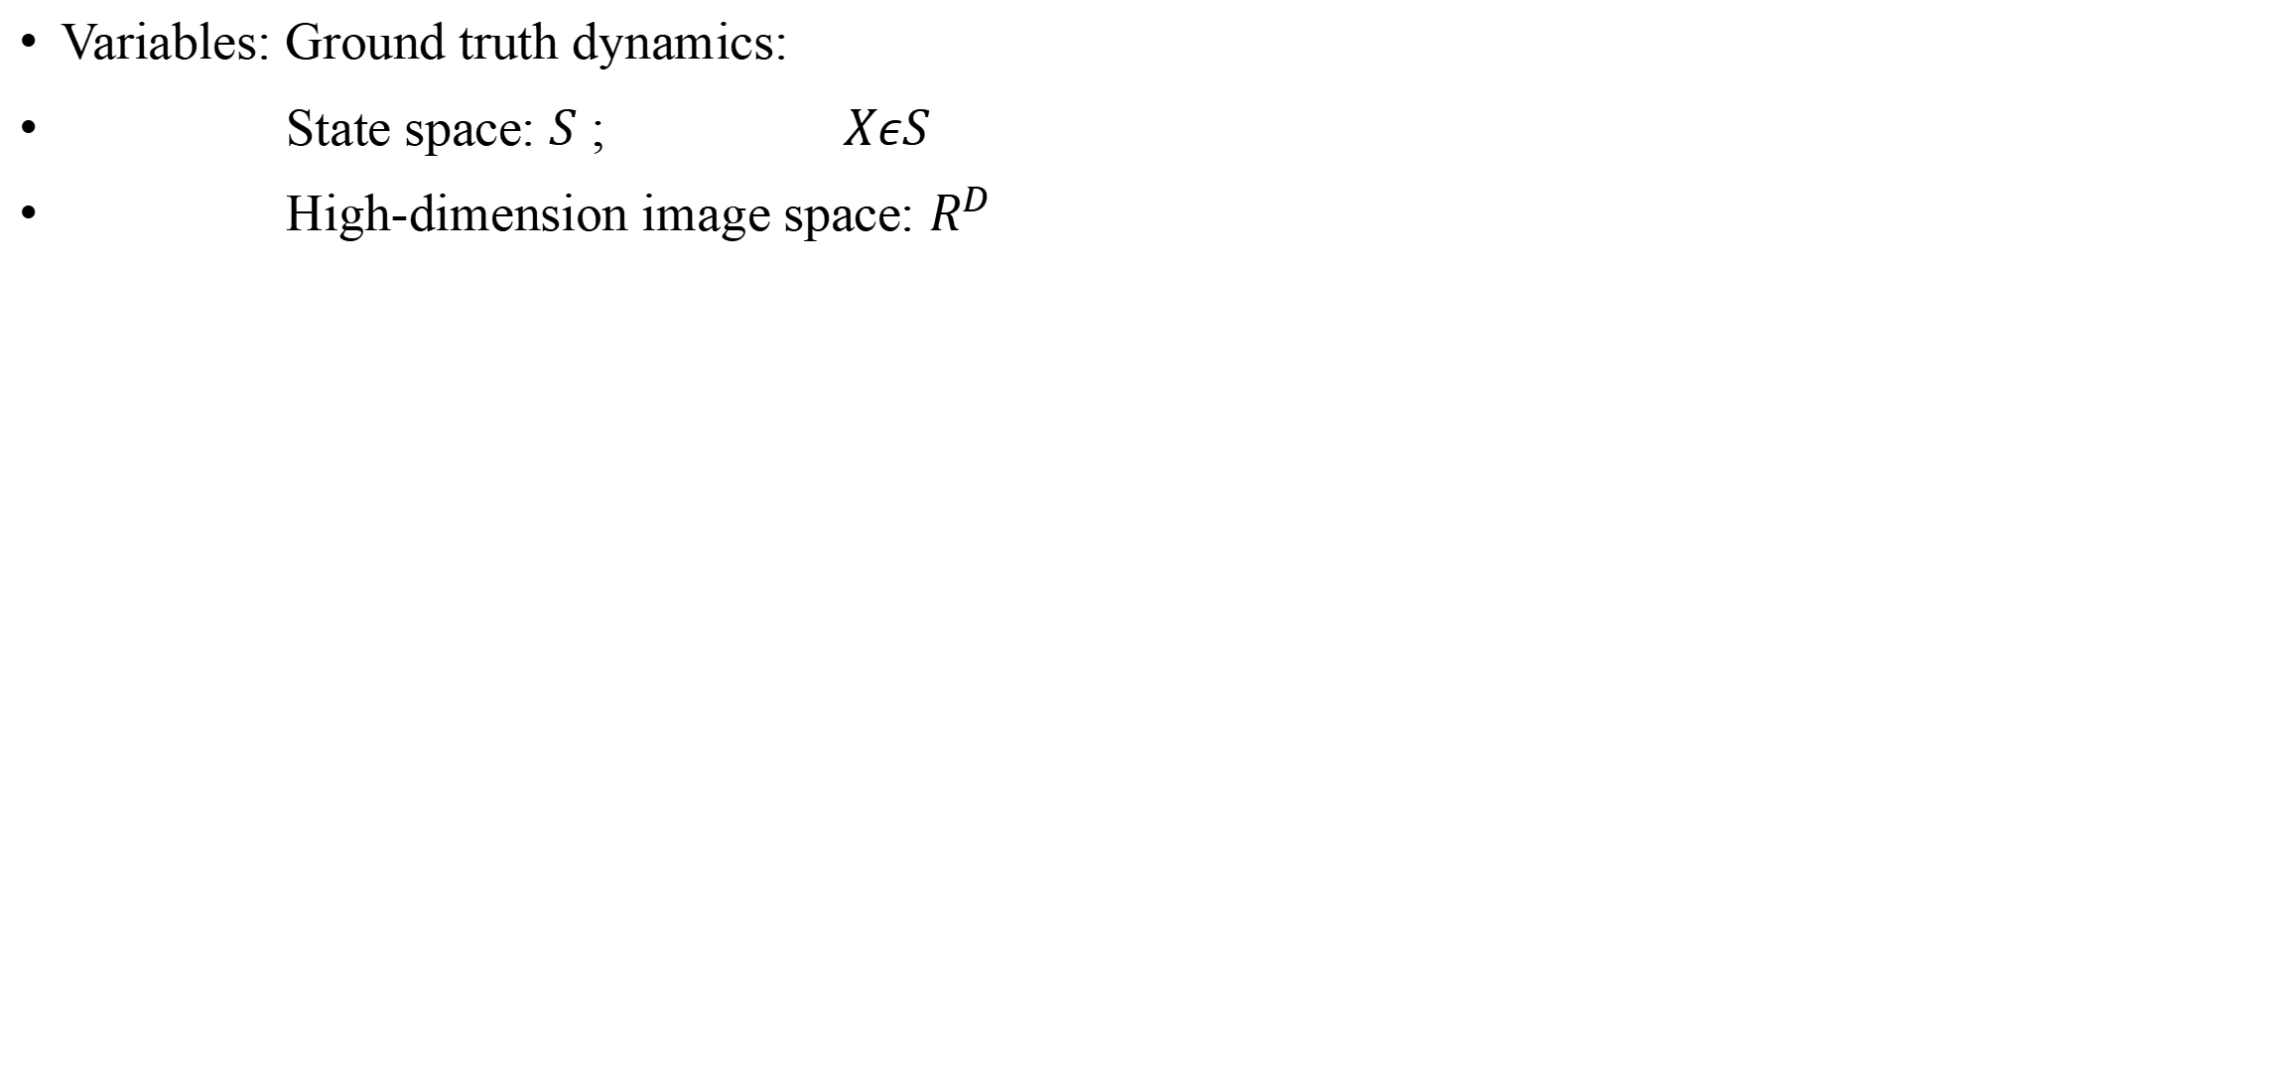
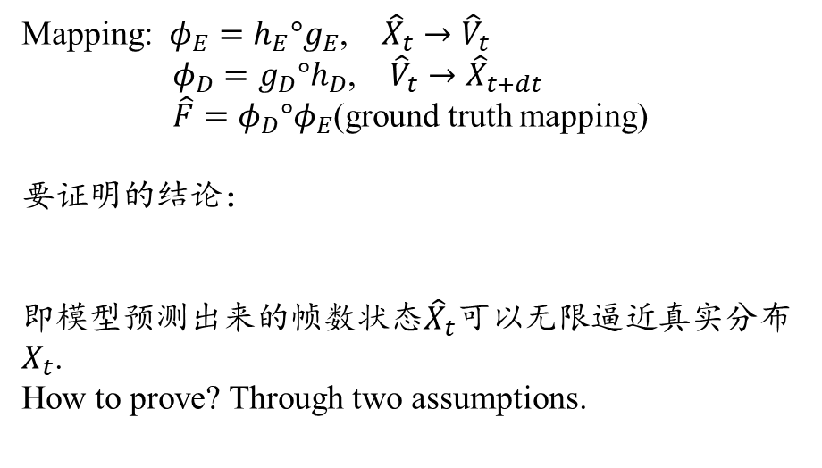
Detail 2 - Math Proof on Long-Term Prediction Stability
Variables: Ground truth dynamics:
State space: $S$ ; $XεS$
High-dimension image space: $R^{D}$
Mapping: $φ_{E}=h_{E}°g_{E}$, ${\hat{X}}_{t}→{\hat{V}}_{t}$
$φ_{D}=g_{D}°h_{D}$, ${\hat{V}}_{t}→{\hat{X}}_{t+dt}$
$\hat{F}=φ_{D}°φ_{E}$(ground truth mapping)
要证明的结论：
即模型预测出来的帧数状态${\hat{X}}_{t}$可以无限逼近真实分布$X_{t}$.
How to prove? Through two assumptions.
Notes:
Fˆ = ϕ D ◦ ϕ E provides an approximation of the ground truth evolution mapping F through Neural State Variables. F是利用了基于流形维度的浅层嵌入层以及神经状态变量而预测出来的X，并不是gE和gD编码器解码器的简单复合。

Slide 16
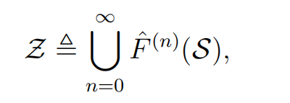
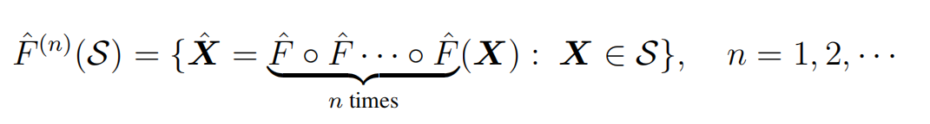
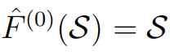
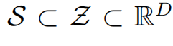
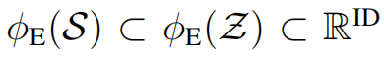
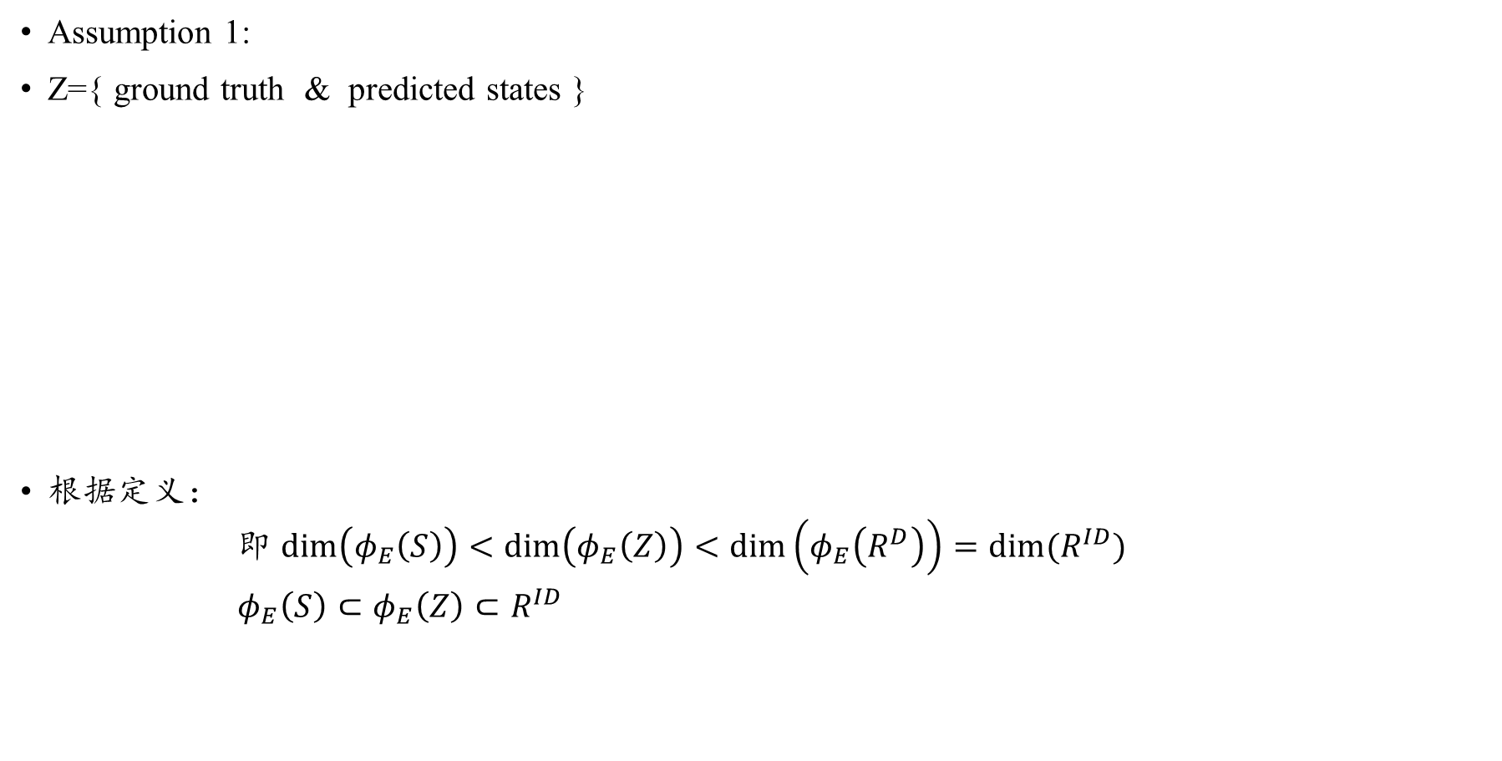
Detail 2 - Math Proof on Long-Term Prediction Stability
Assumption 1:
Z={ ground truth & predicted states }
根据定义：
即 $\dim\left(φ_{E}\left(S\right)\right)<$ $\dim\left(φ_{E}\left(Z\right)\right)<\dim\left(φ_{E}\left(R^{D}\right)\right)=dim⁡(R^{ID})$
$φ_{E}\left(S\right)⊂φ_{E}\left(Z\right)⊂R^{ID}$
Notes:
Z是所有真实状态和预测状态的集合

Slide 17
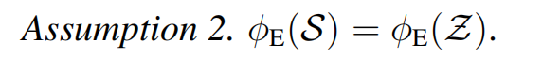
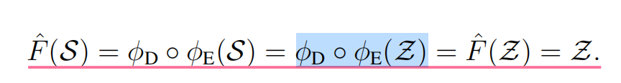
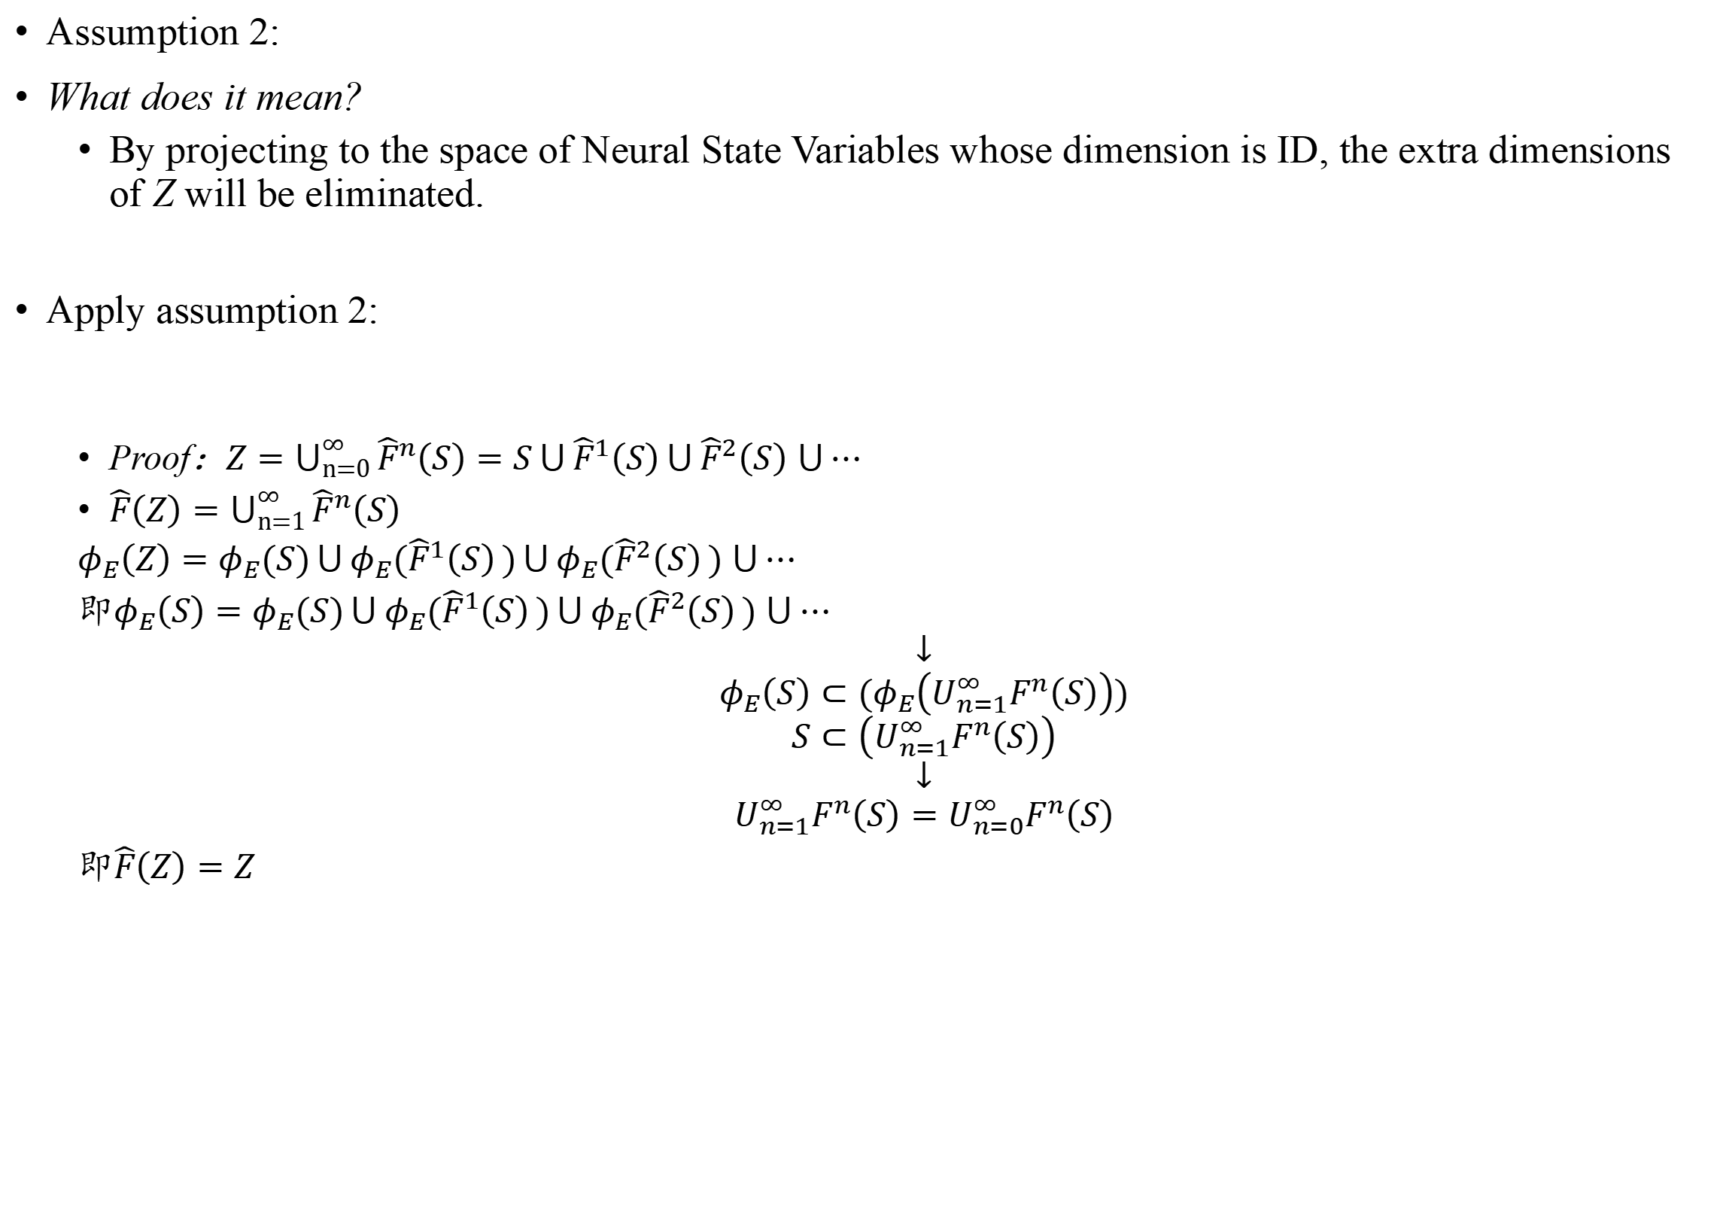
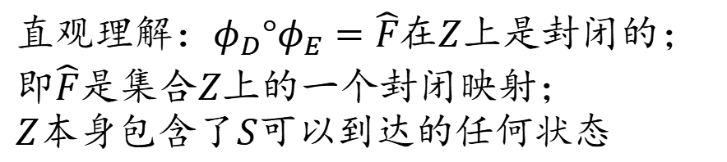
Detail 2 - Math Proof on Long-Term Prediction Stability
Assumption 2:
What does it mean?
By projecting to the space of Neural State Variables whose dimension is ID, the extra dimensions of Z will be eliminated.
Apply assumption 2:
Proof：$Z=\bigcup_{n=0}^{∞}{{\hat{F}}^{n}\left(S\right)=S\bigcup{{\hat{F}}^{1}\left(S\right)}}\bigcup{{\hat{F}}^{2}\left(S\right)}$ $\bigcup{⋯}$
$\hat{F}\left(Z\right)=\bigcup_{n=1}^{∞}{{\hat{F}}^{n}\left(S\right)}$
$φ_{E}\left(Z\right)=φ_{E}(S)\bigcup{{φ_{E}(\hat{F}}^{1}\left(S\right)})\bigcup{{φ_{E}(\hat{F}}^{2}\left(S\right)})$ $\bigcup{⋯}$
即$φ_{E}\left(S\right)=φ_{E}(S)\bigcup{{φ_{E}(\hat{F}}^{1}\left(S\right)})\bigcup{{φ_{E}(\hat{F}}^{2}\left(S\right)})$ $\bigcup{⋯}$
$$↓$$
$$φ_{E}\left(S\right)⊂(φ_{E}\left(U_{n=1}^{∞}F^{n}\left(S\right)\right))$$
$$S⊂\left(U_{n=1}^{∞}F^{n}\left(S\right)\right)$$
$$↓$$
$$U_{n=1}^{∞}F^{n}\left(S\right)=U_{n=0}^{∞}F^{n}\left(S\right)$$
即$\hat{F}\left(Z\right)=Z$
直观理解：$φ_{D}°φ_{E}=\hat{F}$在$Z$上是封闭的；
即$\hat{F}$是集合$Z$上的一个封闭映射；
$Z本身$包含了$S$可以到达的任何状态
Notes:
将一个可能维度更高的空间Z投影到低维度的状态空间S时，额外的维度将被消除，使得这两个空间在特定函数𝜙𝐸ϕE​下的输出相等。
一个对于假设2直观的理解是，S中每一个X都在\phi_E映射到了Neural State Variable中的时候，都和X的预测序列在Neural State Variable的映射呈现双射关系，即两者是误差可控的。

Slide 18
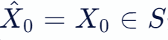
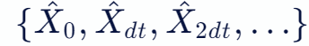
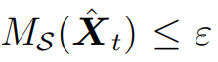
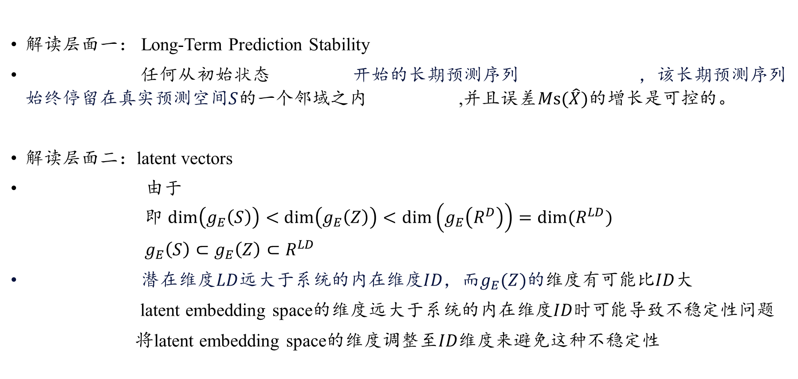
Detail 2 - Math Proof on Long-Term Prediction Stability
解读层面一： Long-Term Prediction Stability
任何从初始状态 开始的长期预测序列 ，该长期预测序列始终停留在真实预测空间$S$的一个邻域之内 ,并且误差$Ms(\hat{X})$的增长是可控的。
解读层面二：latent vectors
由于
即 $\dim\left(g_{E}\left(S\right)\right)<$ $\dim\left(g_{E}\left(Z\right)\right)<\dim\left(g_{E}\left(R^{D}\right)\right)=dim⁡(R^{LD})$
$g_{E}\left(S\right)⊂g_{E}\left(Z\right)⊂R^{LD}$
潜在维度$LD$远大于系统的内在维度$ID$，而$g_{E}(Z)的$维度有可能比$ID$大
latent embedding space的维度远大于系统的内在维度$ID$时可能导致不稳定性问题
将latent embedding space的维度调整至$ID$维度来避免这种不稳定性

Slide 19
THE INTRINSIC DIMENSION OF IMAGES AND ITS IMPACT ON LEARNING
Chapter 1 MLE Algorithm & Comparisons
Chapter 2 Validating dimension estimation with synthetic data
Chapter 3 Intrinsic dimension of popular dataset

Slide 20
Research Background
It is widely believed that natural image data exhibits low-dimensional structure despite the high dimensionality of conventional pixel representations.
Networks learn complex decision boundaries from small amounts of image data (often just a few hundred or thousand samples per class). At the same time, generative adversarial networks (GANs) are able to learn image “mani-folds” from merely a few thousand samples. The seemingly low number of samples needed to learn these manifolds strongly suggests that image datasets have extremely low-dimensional structure.
网络从少量的图像数据（通常只是每个类的几百万或几千个样本）中学习复杂的决策边界。生成式对抗网络（GANs）也能够从几千个样本中学习图像的“流形”。图像数据集具有极低维结构。
Core idea: How to estimate the intrinsic dimension?
Using the MLE estimates (Levina-Bickel’s algorithm)
内在维度（Intrinsic Dimensionality） VS 外在维度（Extrinsic Dimensionality）？
Notes:
尽管传统的像素表示具有高维性，但自然图像数据仍表现出低维结构。

Slide 21
Research Hypothesis
Two Observations:
First, natural images are locally connected, with each image surrounded by other highly similar images reachable through image transformations (e.g., contrast, brightness).
Second, natural images seem to lie on a low-dimensional structure, as the probability distribution of images is highly concentrated; uniformly sampled pixels can hardly assemble a meaningful image.
One Hypothesis:
Natural images lie on or near a low-dimensional manifold.
Notes:
首先，自然图像是局部连接的，每幅图像都被其他高度相似的图像包围，可以通过图像转换（例如，对比度，亮度）获得。
其次，由于自然图像的低维结构，图像的概率分布高度集中；均匀采样的像素很难组装出有意义的图像。

Slide 22
Chapter 1 MLE Algorithm & Comparisons

Slide 23
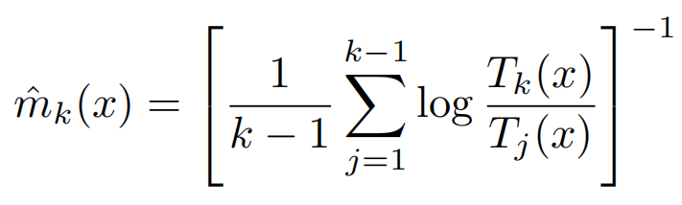
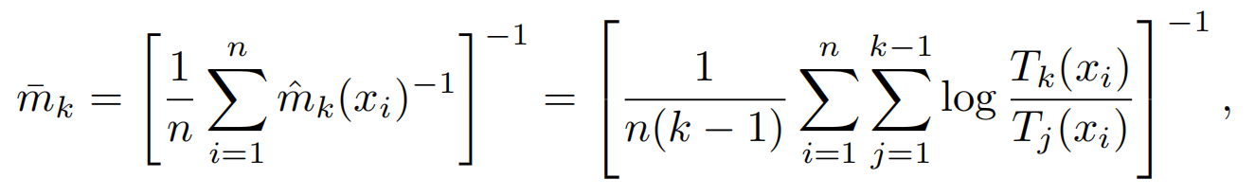
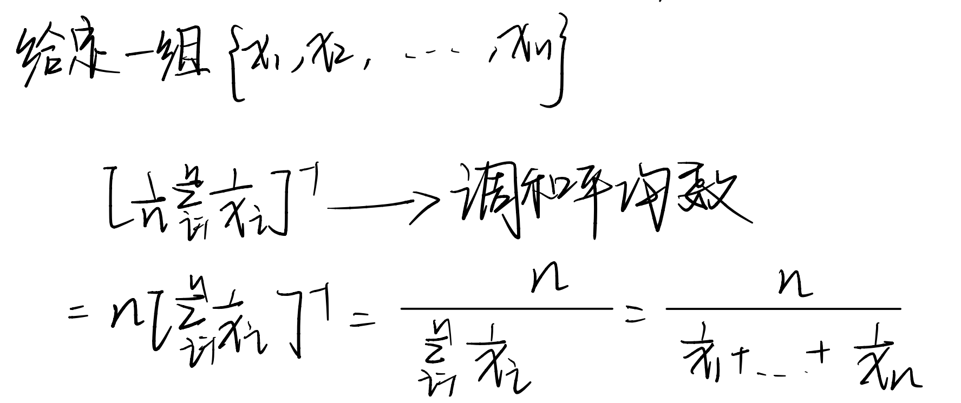
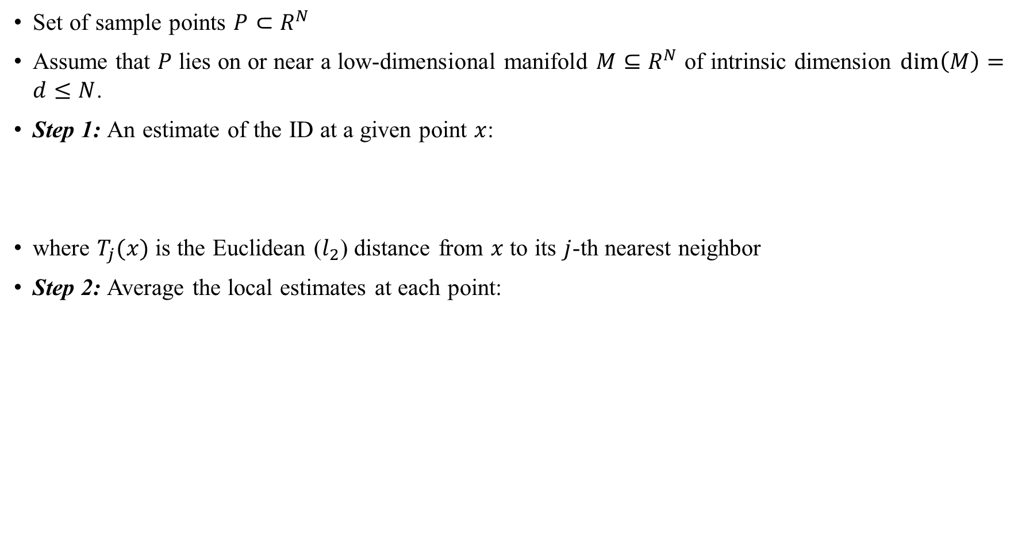
MLE Algorithm(Levina-Bickel’s algorithm)
Set of sample points $P⊂R^{N}$
Assume that $P$ lies on or near a low-dimensional manifold $M⊆R^{N}$ of intrinsic dimension $\dim\left(M\right)=d≤N$.
Step 1: An estimate of the ID at a given point $x$:
where $T_{j}(x)$ is the Euclidean ($l_{2}$) distance from $x$ to its $j$-th nearest neighbor
Step 2: Average the local estimates at each point:
How to calculate the average value?
Harmonic Mean!
Notes:
假设P位于固有维数dim (M) = d <n的低维流形M⊆R^N上或附近。
Levina & Bickel（2005）的最大似然估计（MLE）的本质就是使用泊松过程对每个样本点周围给定半径内随机抽样发现的点数进行建模。
似然方程在给定点x处的ID估计为：

Slide 24
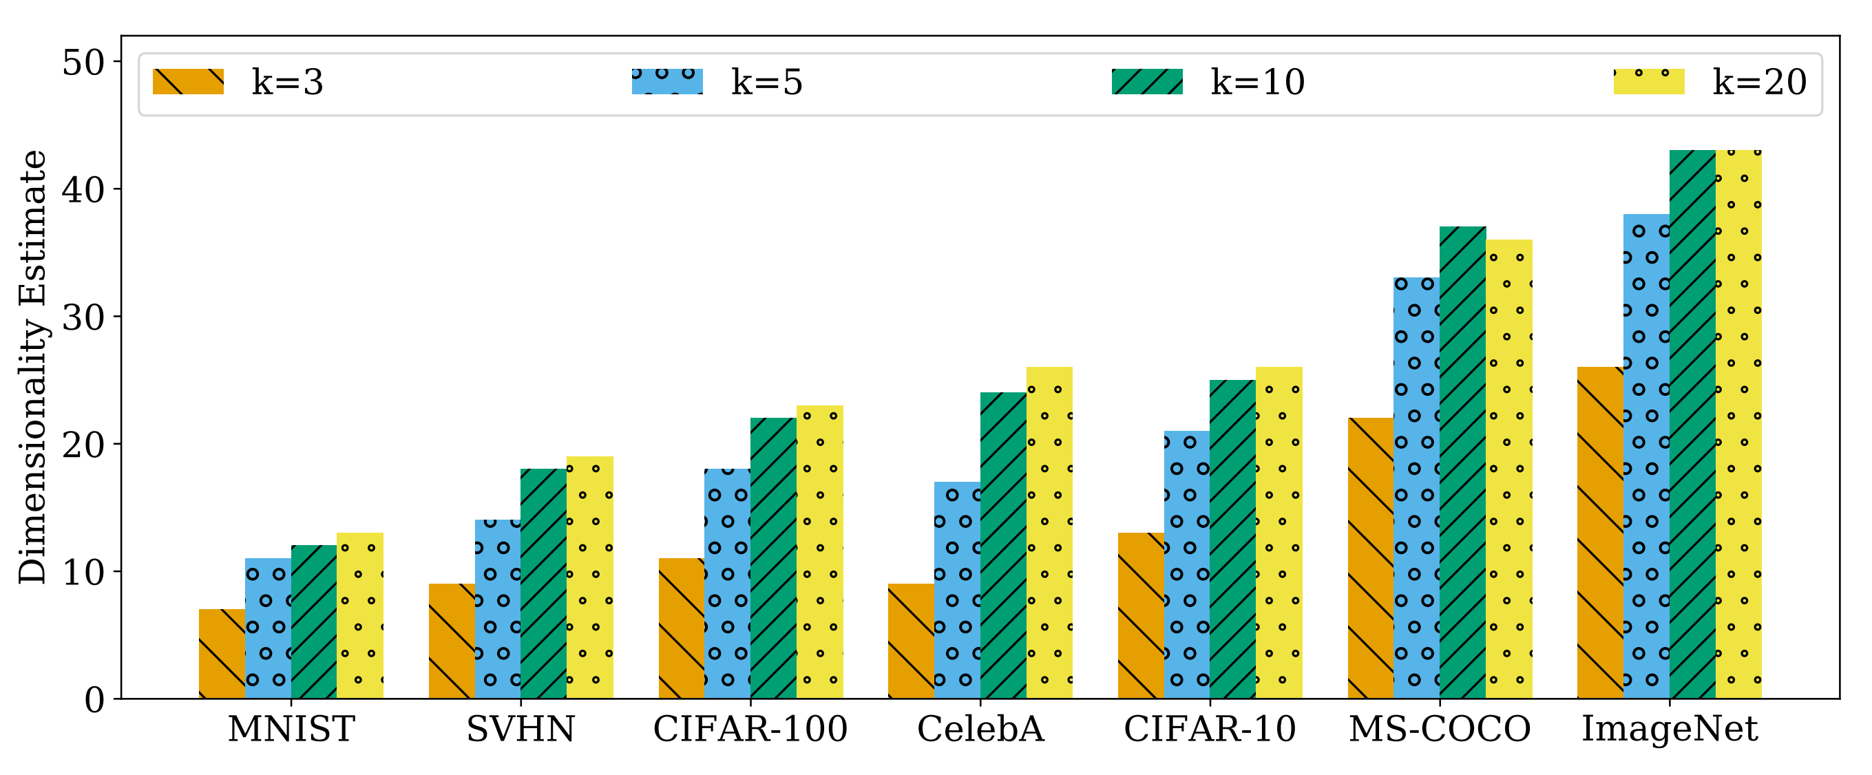
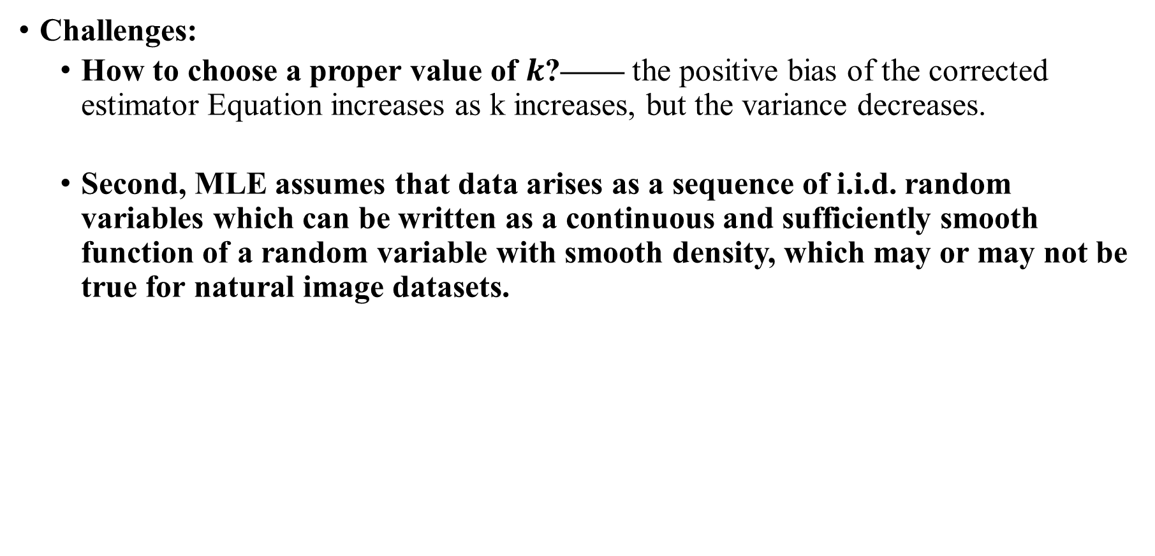
MLE Algorithm(Levina-Bickel’s algorithm)
Challenges:
How to choose a proper value of $k$?—— the positive bias of the corrected estimator Equation increases as k increases, but the variance decreases.
Second, MLE assumes that data arises as a sequence of i.i.d. random variables which can be written as a continuous and sufficiently smooth function of a random variable with smooth density, which may or may not be true for natural image datasets.
Notes:
首先，我们需要选择一个合适的k值。如MacKay & Ghahramani（2005）所示，校正后的估计量方程(2)的正偏差随着k的增加而增加，但方差减小。
其次，MLE假设数据有一系列独立同分布的随机变量组成，数据由一系列独立同分布的随机变量序列组成，这些变量可以被写为一系列足够光滑smooth和连续的函数，并且其概率论密度函数也是smooth光滑的。

Slide 25


Comparison with other estimators
GeoMLE: Polynomial regression of standard MLE based on distances to nearest neighbors in different sized neighborhoods.
What’s different? 没有使用调和平均数！
we sample a total of 20 bootstrap subsets (M = 20) and use parameters as recommended.
TwoNN-graph distance: TwoNN is based on the ratio of the distances to the first and second nearest neighbors.
Shortest-Path Estimate: we randomly sample a subset of samples (fixed to 10,000 for datasets with more than 10,000 samples) and use shortest graph distances to their k-nearest neighbors to estimate the IDs.
Notes:
对于GeoMLE，基于在不同大小的邻域中到最近邻的距离的标准MLE的多项式回归。
我们总共采样了20个引导子集（M = 20），并按照建议使用k1 = 20，k2 = 55.
我们随机抽样一个样本子集（对于有超过10,000个样本的数据集，固定为10,000个），并使用它们的k个最近邻的最短图距离来估计id。
实线：代表真实的数据维度

Slide 26

Comparison with other estimators
Test dataset:
uniformly sampled from d-dimensional hypercubes!
Report:
low-dimensional cubes: all work well
Higher dimension: GeoMLE!
Higher dimension: Shortest Path?
erratic estimates
TwoNN?
poor sample efficiency

Slide 27



Comparison with other estimators
Test Dataset: synthetic basenji data with $d=10$ free entries
Convergence of the MLE estimate on basenji data

Slide 28

Comparison with other estimators
Estimates of the intrinsic dimension of commonly used datasets obtained using the MLE method with k = 3, 5, 10, 20 nearest neighbors (left to right).

Slide 29
Chapter 2 Validating dimension estimation with synthetic data

Slide 30


Validating dimension estimation with synthetic data
Challenge: However, because we lack knowledge of the exact dimensionality of image datasets, we cannot directly verify that MLE-based dimensionality estimates scale up to the complexity of image structures.
First, we cannot be sure if the dataset actually resembles a sampling of points on or near a manifold. Second, there are typically no guarantees that the sampling satisfies the conditions assumed by the ID estimators we are using.
（MLE assumes that data arises as a sequence of i.i.d. random variables which can be written as a continuous and sufficiently smooth function of a random variable with smooth density, which may or may not be true for natural image datasets.）
GAN Images: We generate datasets with a varying number of images, where we fix most entries of the latent vectors to zero leaving only $d$ free entries to be chosen at random.
Notes:
首先，我们不能确定数据集是否实际上类似于流形上或附近的点的采样。其次，通常不能保证抽样满足我们所使用的ID估计器所假设的条件。
首先，我们不能确定数据集是否实际上类似于流形上或附近的点的采样。
其次，通常不能保证抽样满足我们所使用的ID估计器所假设的条件。
使用这个GAN，我们生成具有不同数量图像的数据集，其中我们将潜在向量的大部分条目固定为零，仅留下d个自由条目随机选择。
意思就是一个向量128维度，[x_1,……,x_128]，其中我抽取\overline{d}个元素不为0，并且随机生成数字，然后根据组合成的向量去生成图像，再提取这个图象的ID维度（一般认为ID<=\overline{d}，可以认为\overline{d}是当前状态空间S的维度，128则是高维图像像素空间的维度。当我们增加自由项的数量时，我们期望内在维数以d¯为上界而增加；

Slide 31



Validating dimension estimation with synthetic data
Use the BigGAN variant with 128 latent entries and outputs of size 128×128×3 trained on the ImageNet dataset.
Generation method:
fix most entries of the latent vectors to zero
leaving only $d$ free entries to be chosen at random
Sensitive to $k$!

Slide 32
Comparison with other estimators
Test Dataset: synthetic basenji data with $d=10$ free entries
Convergence of the MLE estimate on basenji data

Slide 33

Validating dimension estimation with synthetic data
Note that the estimates do not converge around the upper bound of d= 10, which suggests that data generated from this class is not of full dimension.

Slide 34
Chapter 3 Intrinsic dimension of popular dataset & generalization

Slide 35


Intrinsic dimension of popular dataset
内在维度越高，测试准确率可能会越低。比如，一个数据集的内在维度较高，其最先进模型的分类准确率往往较低，反之亦然。
https://paperswithcode.com/task/image-classification
100%
99.99%
96.08%
99.5%
92.40%

Slide 36

Intrinsic dimension matters for generalization
Hypothesis 1: (1) data of lower intrinsic dimensionality has lower sample complexity than that of higher intrinsic dimensionality
we create four synthetic datasets of varying intrinsic dimensionality: 16, 32, 64, 128, fixed extrinsic dimensionality: 3×32×32, and two classes: basenji and beagle.
Test Size: N=1700
Training Architecture: ResNet-18 (width = 64)
Synthetic Data!

Slide 37


Intrinsic dimension matters for generalization
Sample Complexity: MNIST<CIFAR10,SVHN<IMAGENET
Real Data!

Slide 38

Intrinsic dimension matters for generalization
Hypothesis 2: extrinsic dimensionality is irrelevant for sample complexity
We create four synthetic datasets of varying extrinsic dimensionality by resizing the images with nearest-neighbor interpolation.
Training set: 6 datasets of square, 3-channel images of sizes 16, 32, 64, 128, 256, ID=128(fixed)
Test Size: N=1700
Training Architecture: ResNet-18 (width = 64)
Notes:
我们通过最近邻插值调整图像大小，创建四个不同外部维度的合成数据集。具体来说，我们创建了6个大小为16、32、64、128、256的3通道方形图像数据集，固定的内在维度大小为128，以及所有其他实验细节。我们将在图5中显示这些结果。观察到可变增长率的缺乏，我们看到外部维度对样本的复杂性几乎没有影响。

Slide 39



Adding noise changes dimensionality to affect generalization
We thus add independent noise, drawn uniformly from a fixed randomly oriented $d$-dimensional unit hypercube embedded in pixel space, to each sample in a dataset.
Add noise of varying dimensions.
Starting with CIFAR-10 data, we add noise of varying dimensions, 256, 512, 1024, 2048, 2560.
Notes:
真实数据：添加噪声变化的维数来影响泛化
因此，我们将独立的噪声，从嵌入在像素空间中的一个固定的随机定向的d维单位超立方体中均匀地添加到一个数据集中的每个样本中。
由于我们使用的自然数据具有低维数，而超立方体具有高维数，因此这个过程特别增加了维数。由于数据集中图像的变化可能仍然由非噪声方向主导，我们预计会低估这些噪声数据集新增加的维度。

